Slide 1
Etch-A-Sketch
Peter Heath
Matthew Schack

Slide 2
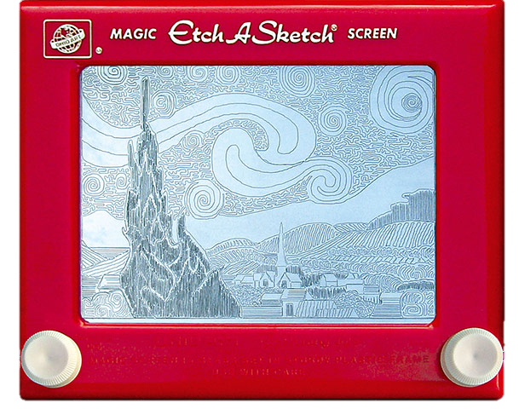
Project Objectives
Use the ADC to read two potentiometers to write locations to the steppers
Be able to perform preprogramed paths

Slide 3
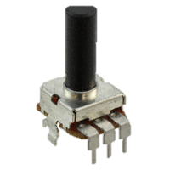
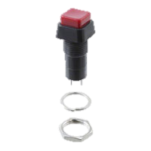
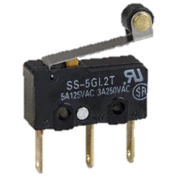
Inputs
We used two 1 MΩ potentiometers to control the position
We used 3 push buttons for extra input
4 limit switches were used for homing

Slide 4
The PIC
We used the PIC to read the ADC and convert this to a position
In addition we used the limit switches to determine the size of the work space
We also used timer interrupts for the control of the stepper motors

Slide 5
Code Flowchart
Setup PIC
Home
Read ADC
Move steppers
Button Y
N
Draw path
Stop Y
N

Slide 6
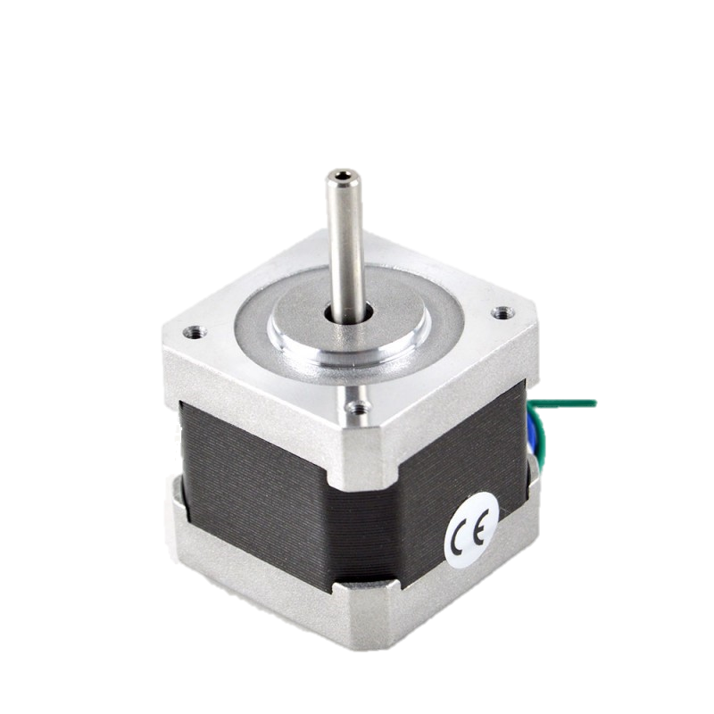
Outputs
The outputs of the system were the stepper motors

Slide 7
Results
The project for the most part works as planned with one major exception. Our X-axis has two sliders on it which caused the system to bind when the belts tried to move it.

Slide 8
Recommendations
To properly implement this kind of a system we would recommend a drive system for each slider used as well as keeping the belt attachment as close to the sliders as possible.

